Slide 2
Murhur NS Active School Coordinator: Ms. Finnegan

Slide 3
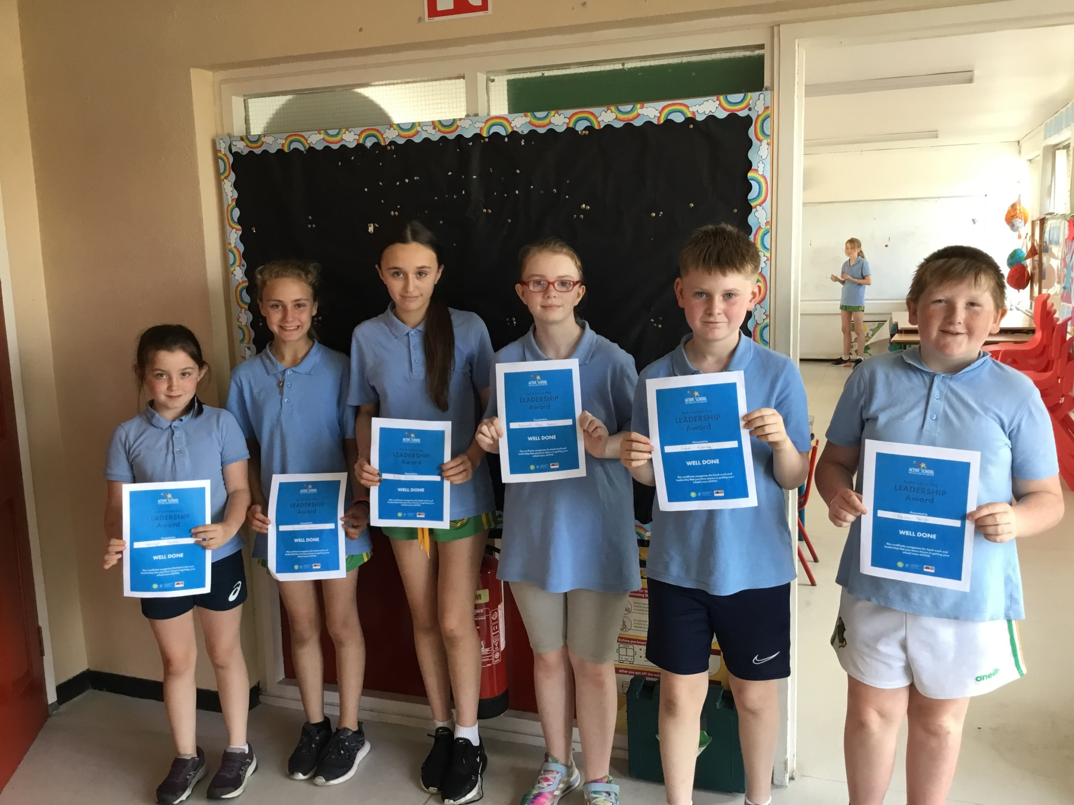
Our A.S.F. Committee

Slide 4
Our Parental Involvement -
Parents that got involved in coaching GAA and badminton.

Slide 5
Active Homework
We encourage Active Homework every week and have a template on our website where children can choose what activity they would like to complete. They write in their diaries what activity they have completed that night.

Slide 6
Physical Education
Mrs. O’Flaherty completed training on Mental Health and Wellbeing through PE and Ms. Finnegan completed a level 1 Athletics course .
They reported back to the staff during our Croke Park meeting for an hour.
Each teacher decided to teach a fundamental skill each month.
Each teacher concentrated on the teaching points from the PDST website and the Move Well Move Often Teacher Manual in class and the children assessed each other.
All strands of the PE curriculum are taught every year.

Slide 7
PE long term grid
Month | September | October | November | December | January
Strand | Games | Athletics | Athletics | Games | Gymnastics
FMS | Running/walking | Jumping for length | Jumping for height | Skipping | Balance
Month | February | March | April | May | June
Strand | Gymnastics | Dance | Athletics | Outdoor & Adventure/Games | Outdoor & adventure
FMS | Balance | Skipping | Striking with the hand | Striking with an implement | Revision

Slide 8
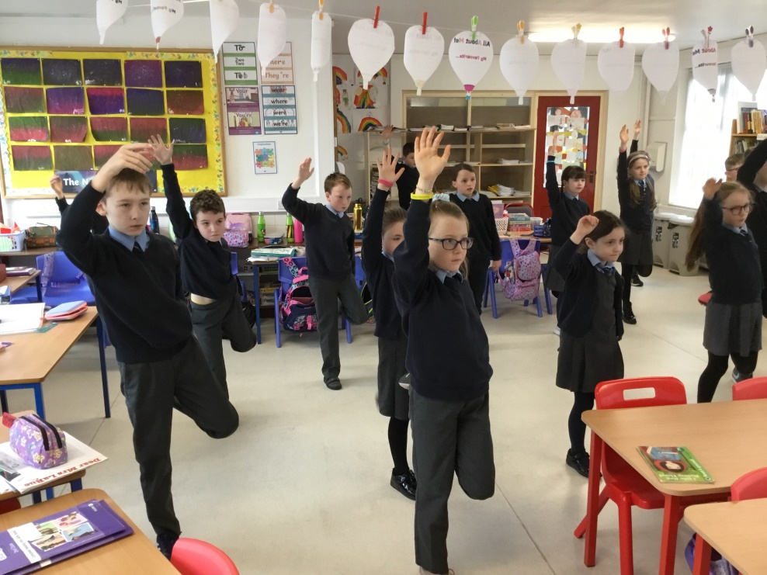
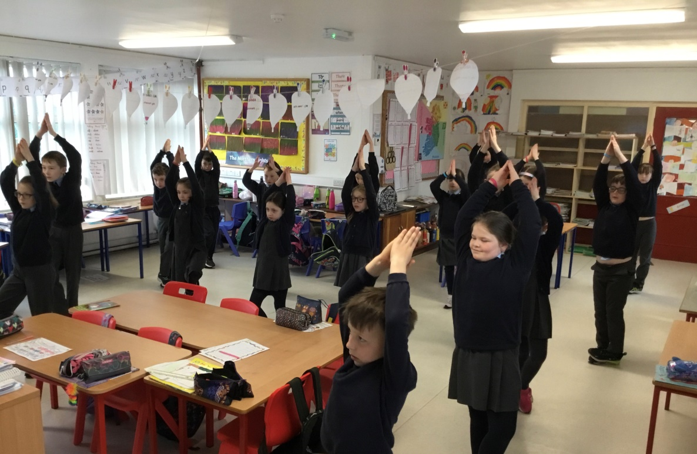
Fundamental movement skill: balance

Slide 9
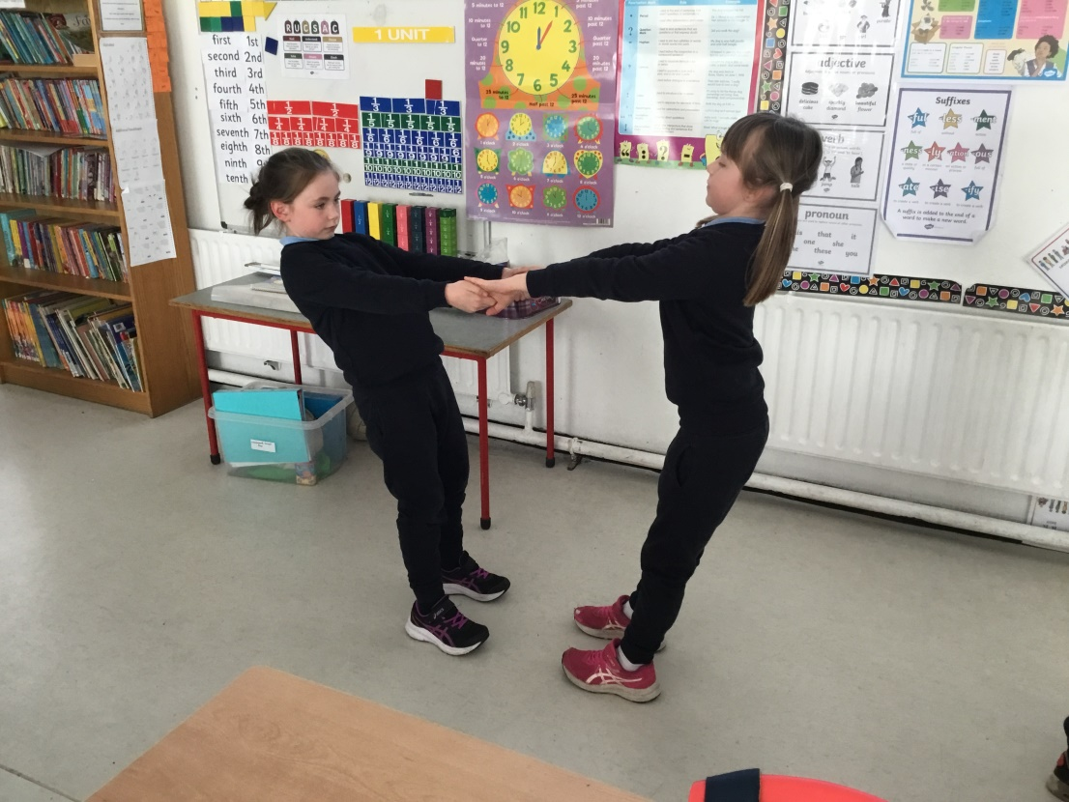
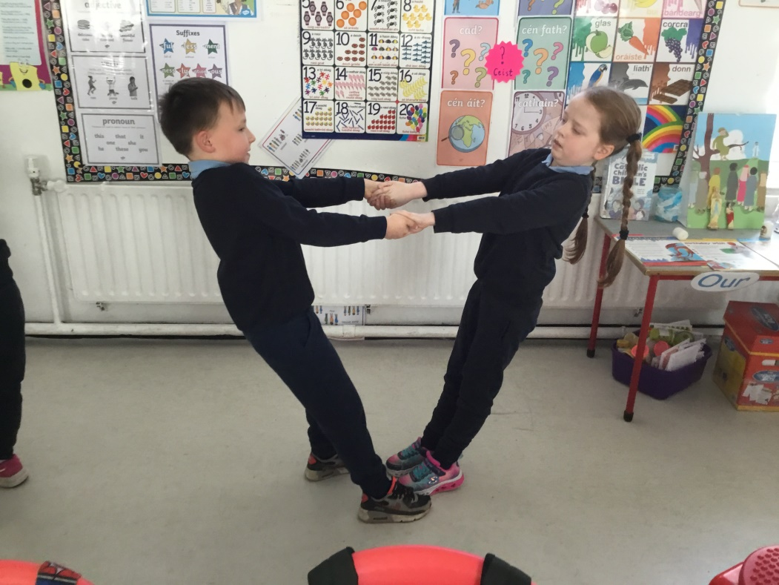

Slide 10
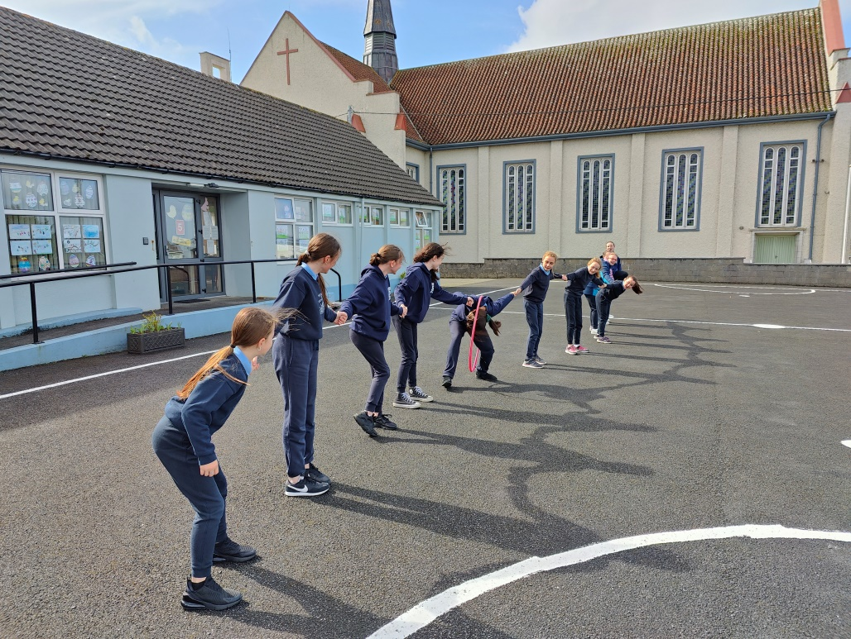
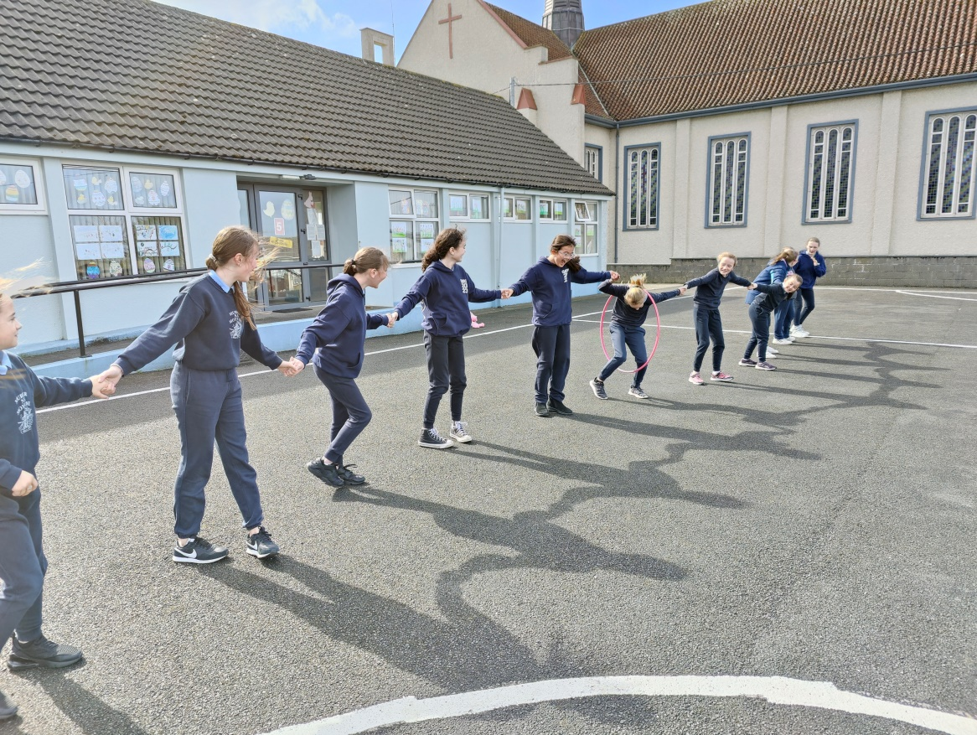

Slide 11
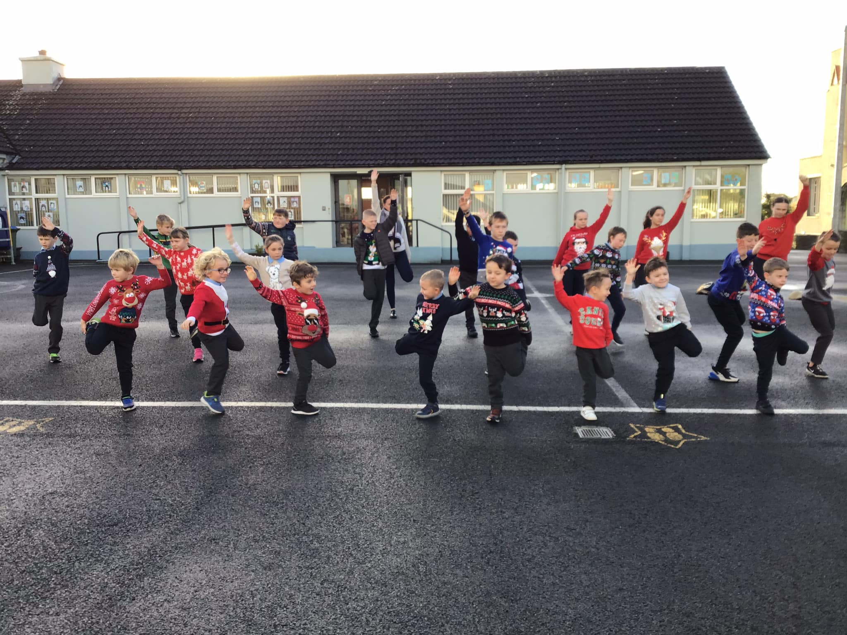

Slide 12
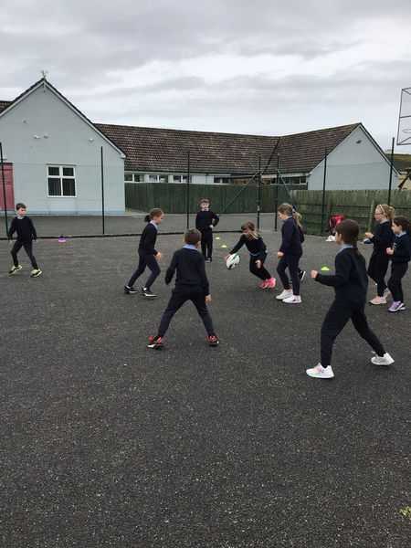
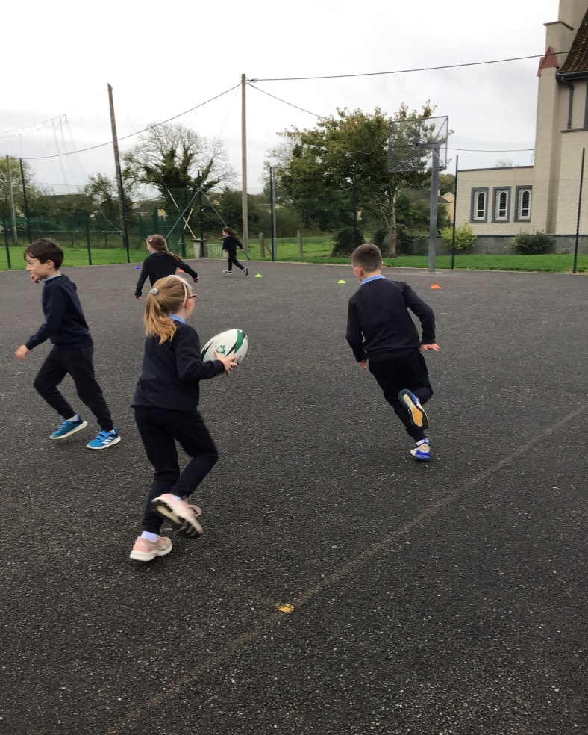
Rugby:
Children completed six weeks of coaching in tag rugby and touch rugby. Developing their ball handling, passing, dodging and movement skills.

Slide 13
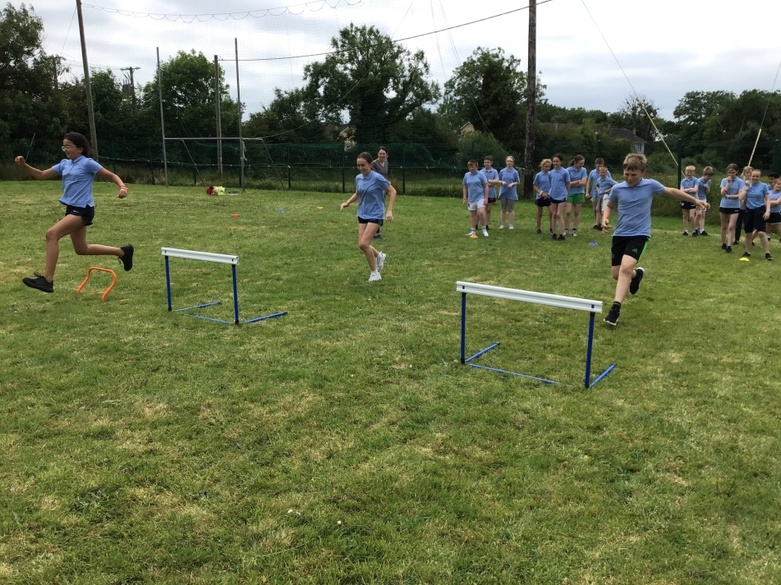
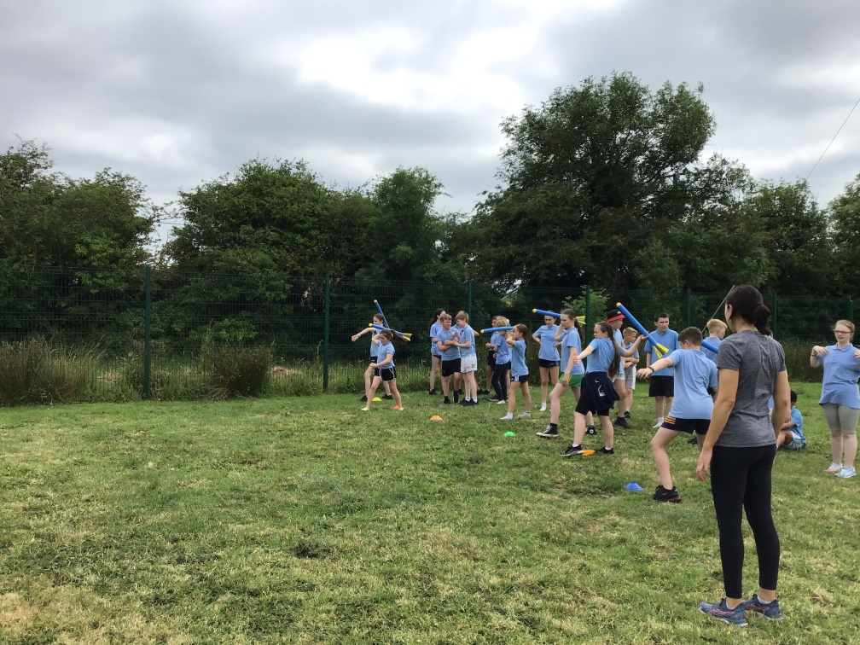
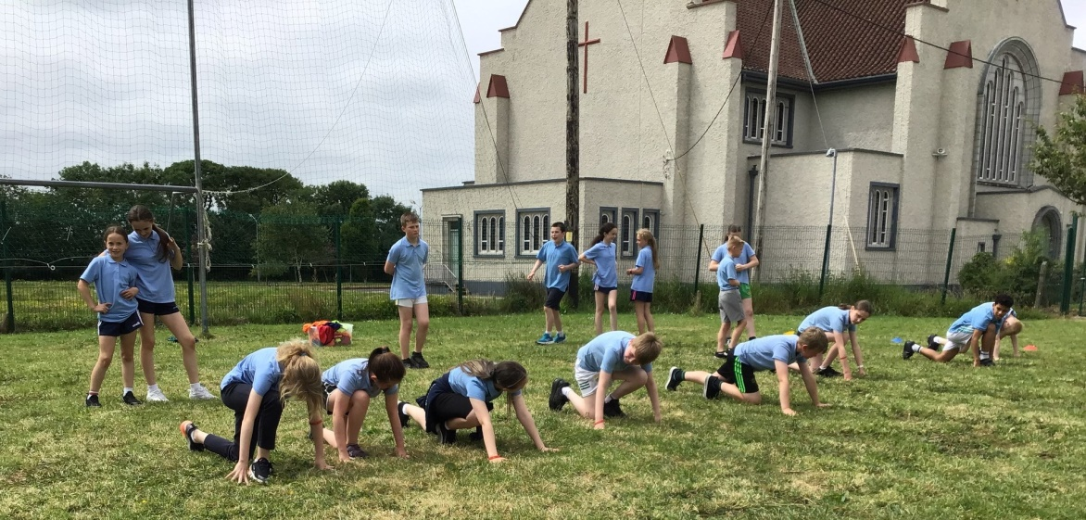
Athletics:
Ms. Finnegan is a qualified Athletics Level 1 coach and she has brought this knowledge to the school by coordinating with other teachers, teaching the fundamental skills of jumping , running and throwing and teaching the Athletics strand.

Slide 14
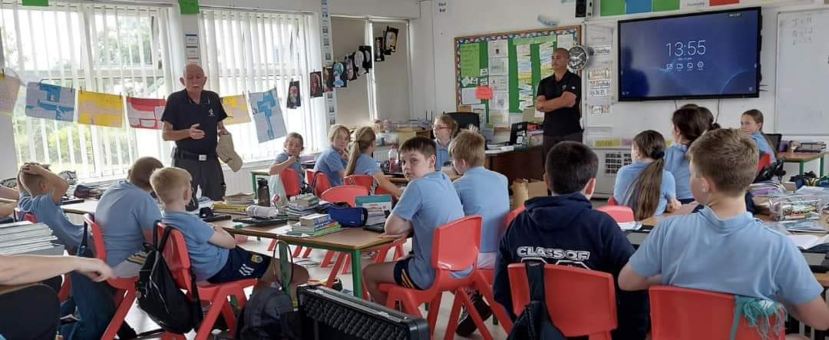
PAWS and Water Safety

Slide 15
Physical Activity
We undertook a lot of extra physical activity throughout this year. Each teacher completed the Active Break challenge and is committed to including more active breaks and activities into the daily schedule.
Festive Activities
Running Initiatives – daily mile completed
Bizzie Breaks and Go Noodle on wet days.
Playground Activities with playground leaders.
Nature Walks and Treasure Hunts

Slide 16
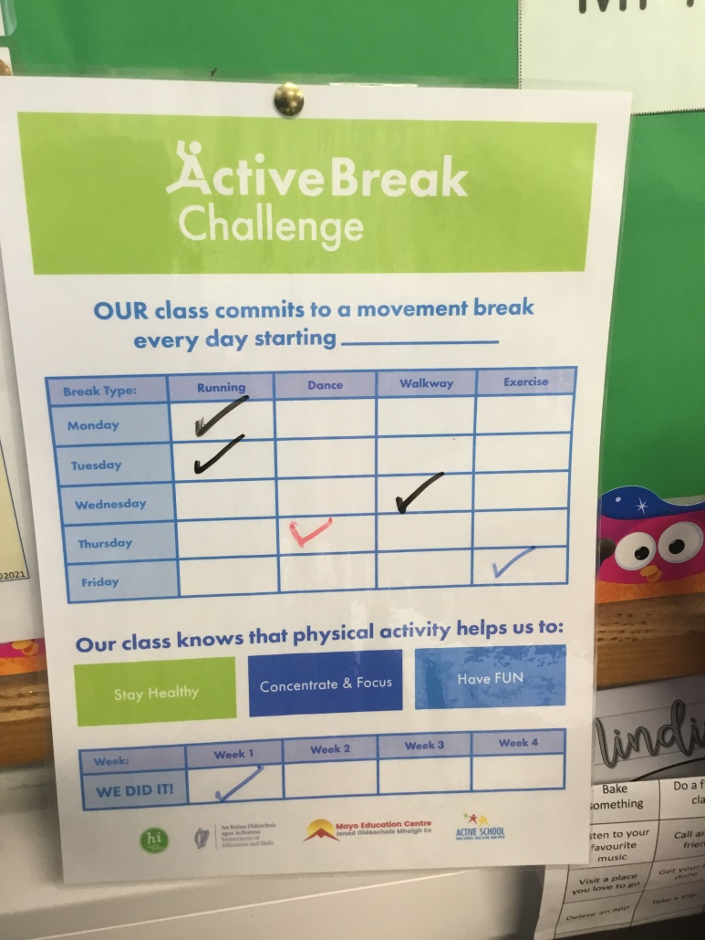
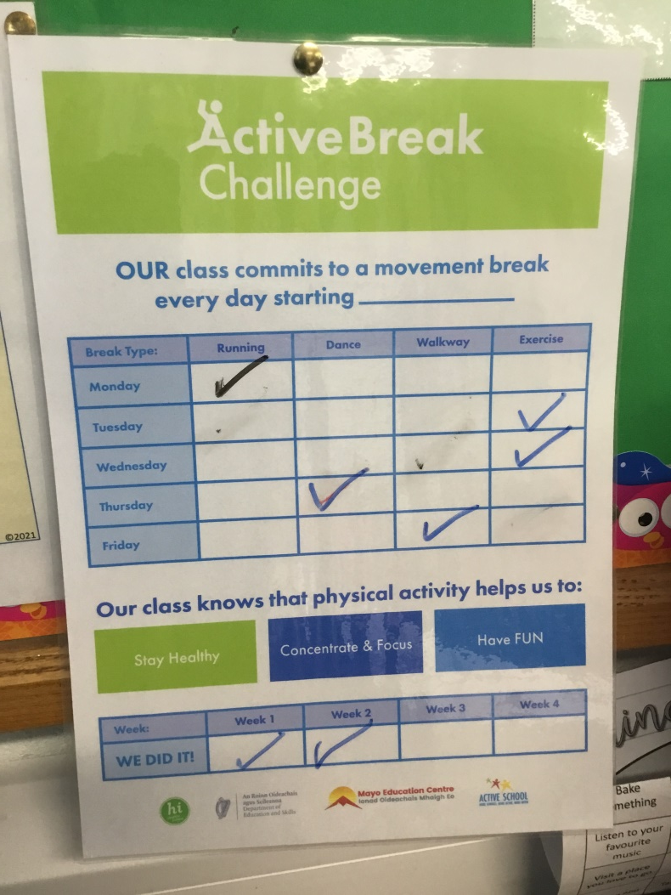
Movement Breaks
Each teacher was committed to the challenge of implementing active breaks into their daily routine.

Slide 17
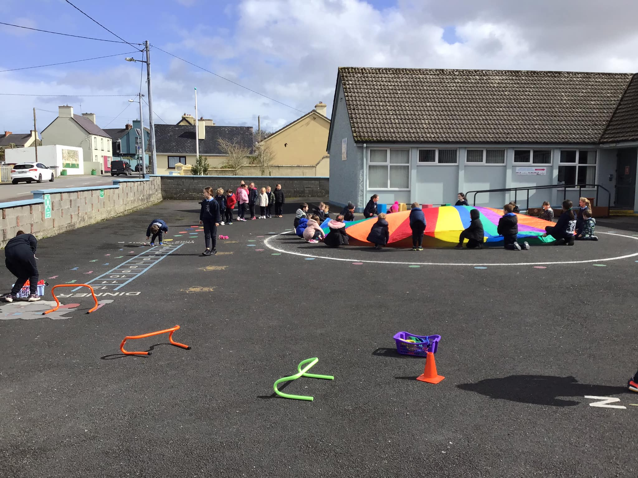
At yard time we use equipment to have fun and to make use of the yard markings.

Slide 18
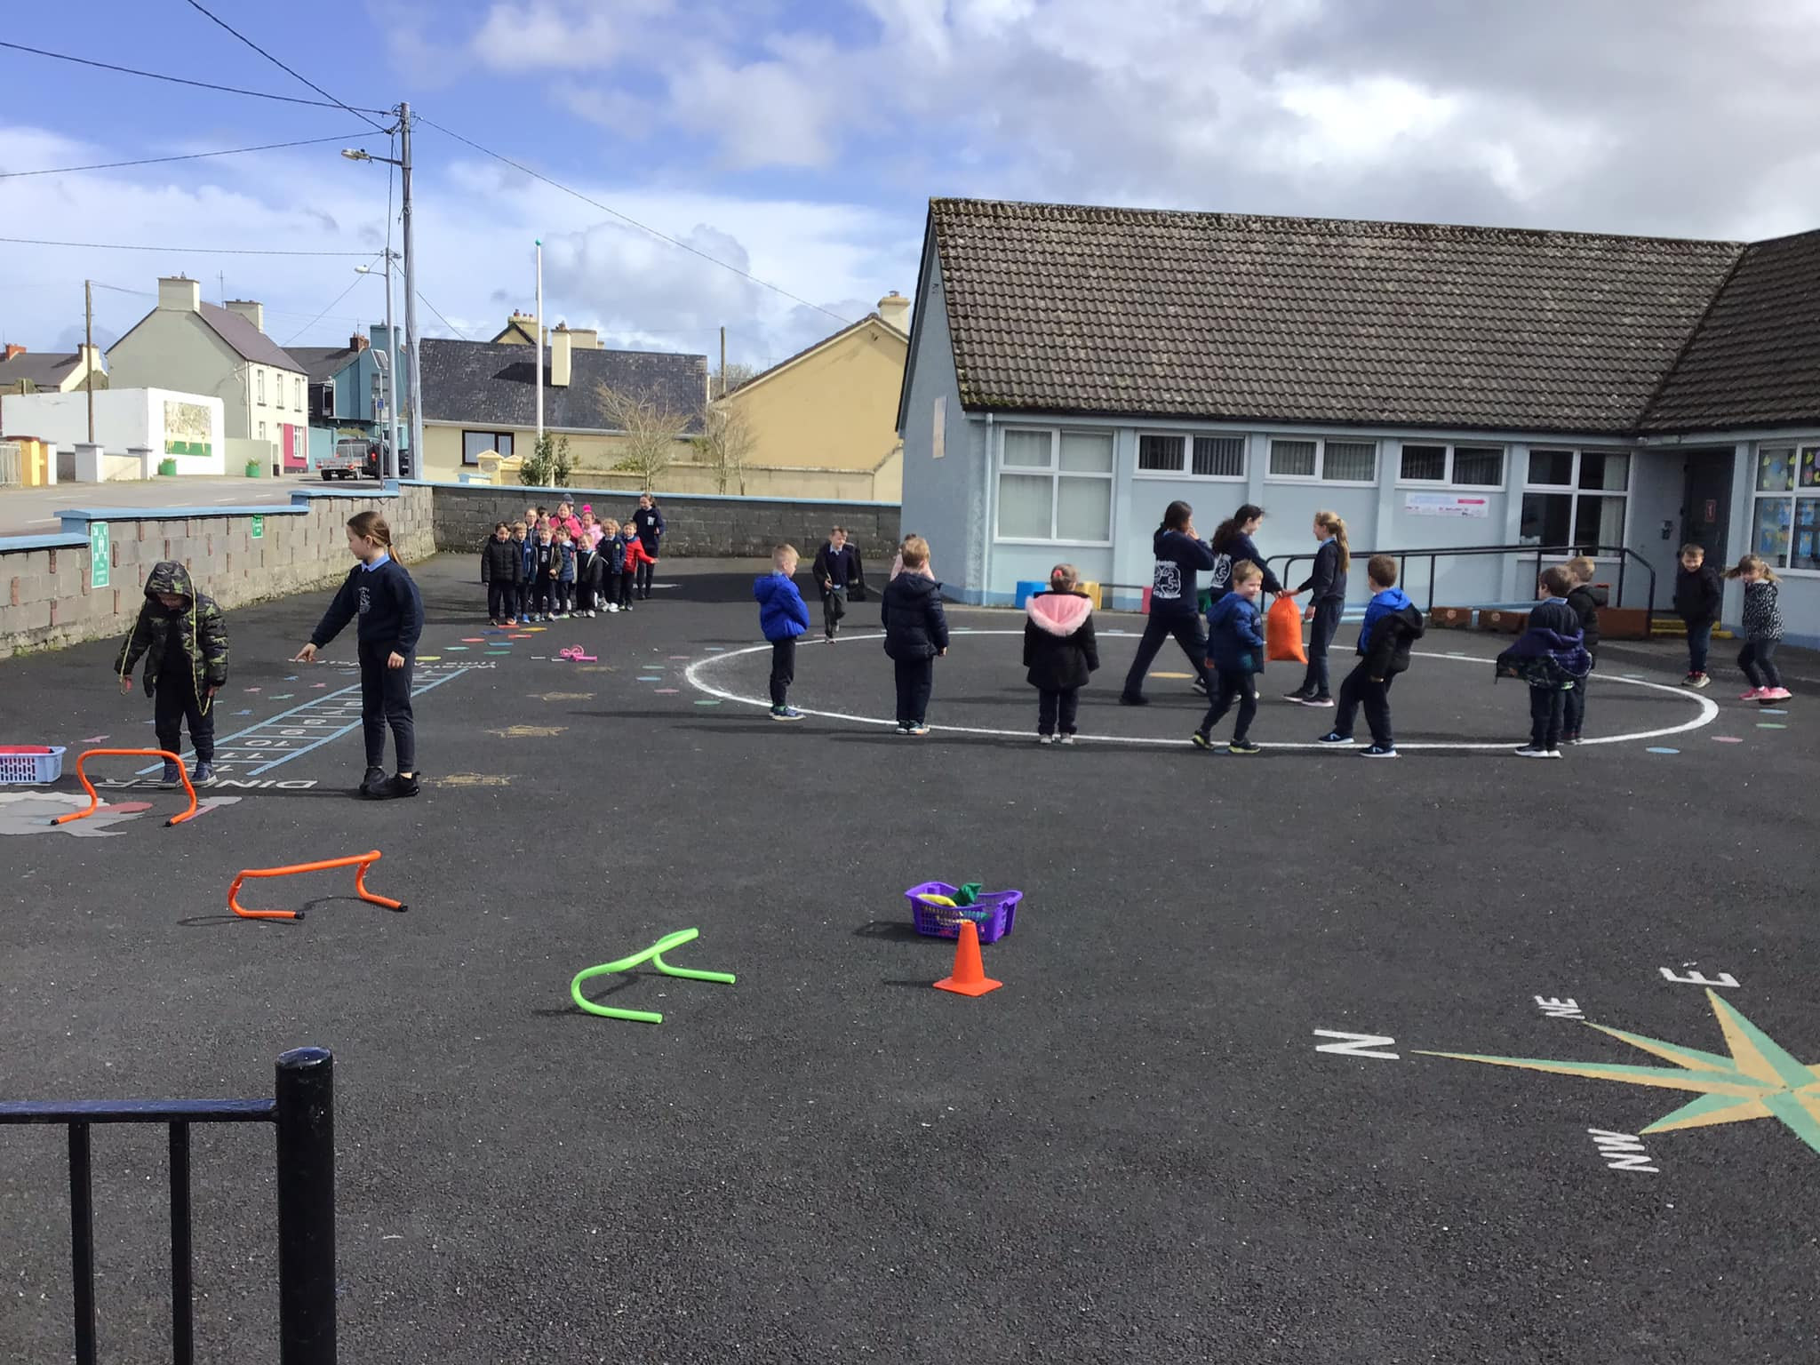
The senior classes buddy up with the junior classes to organise games and activities.

Slide 19
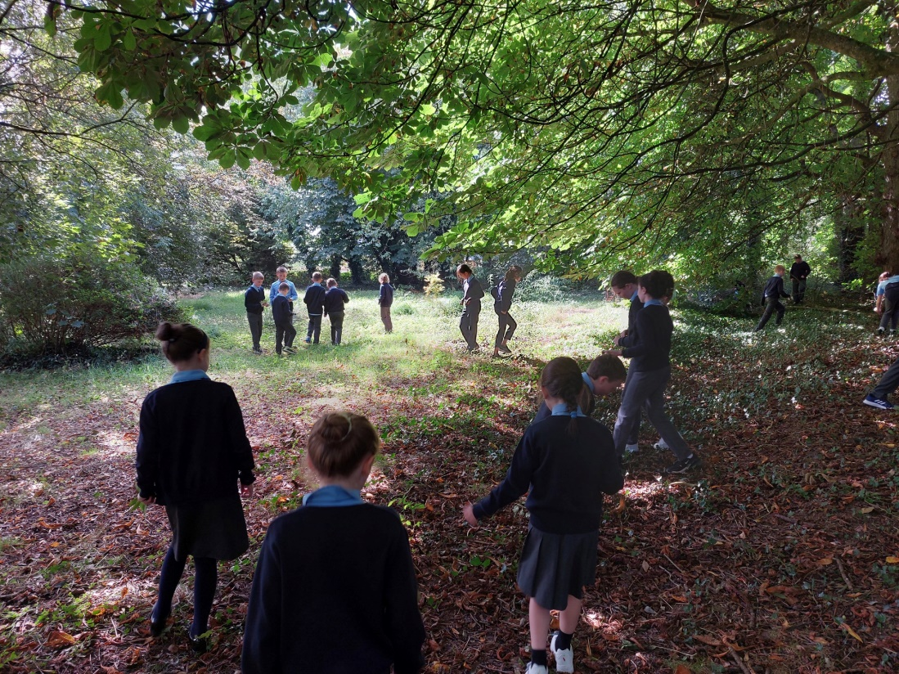
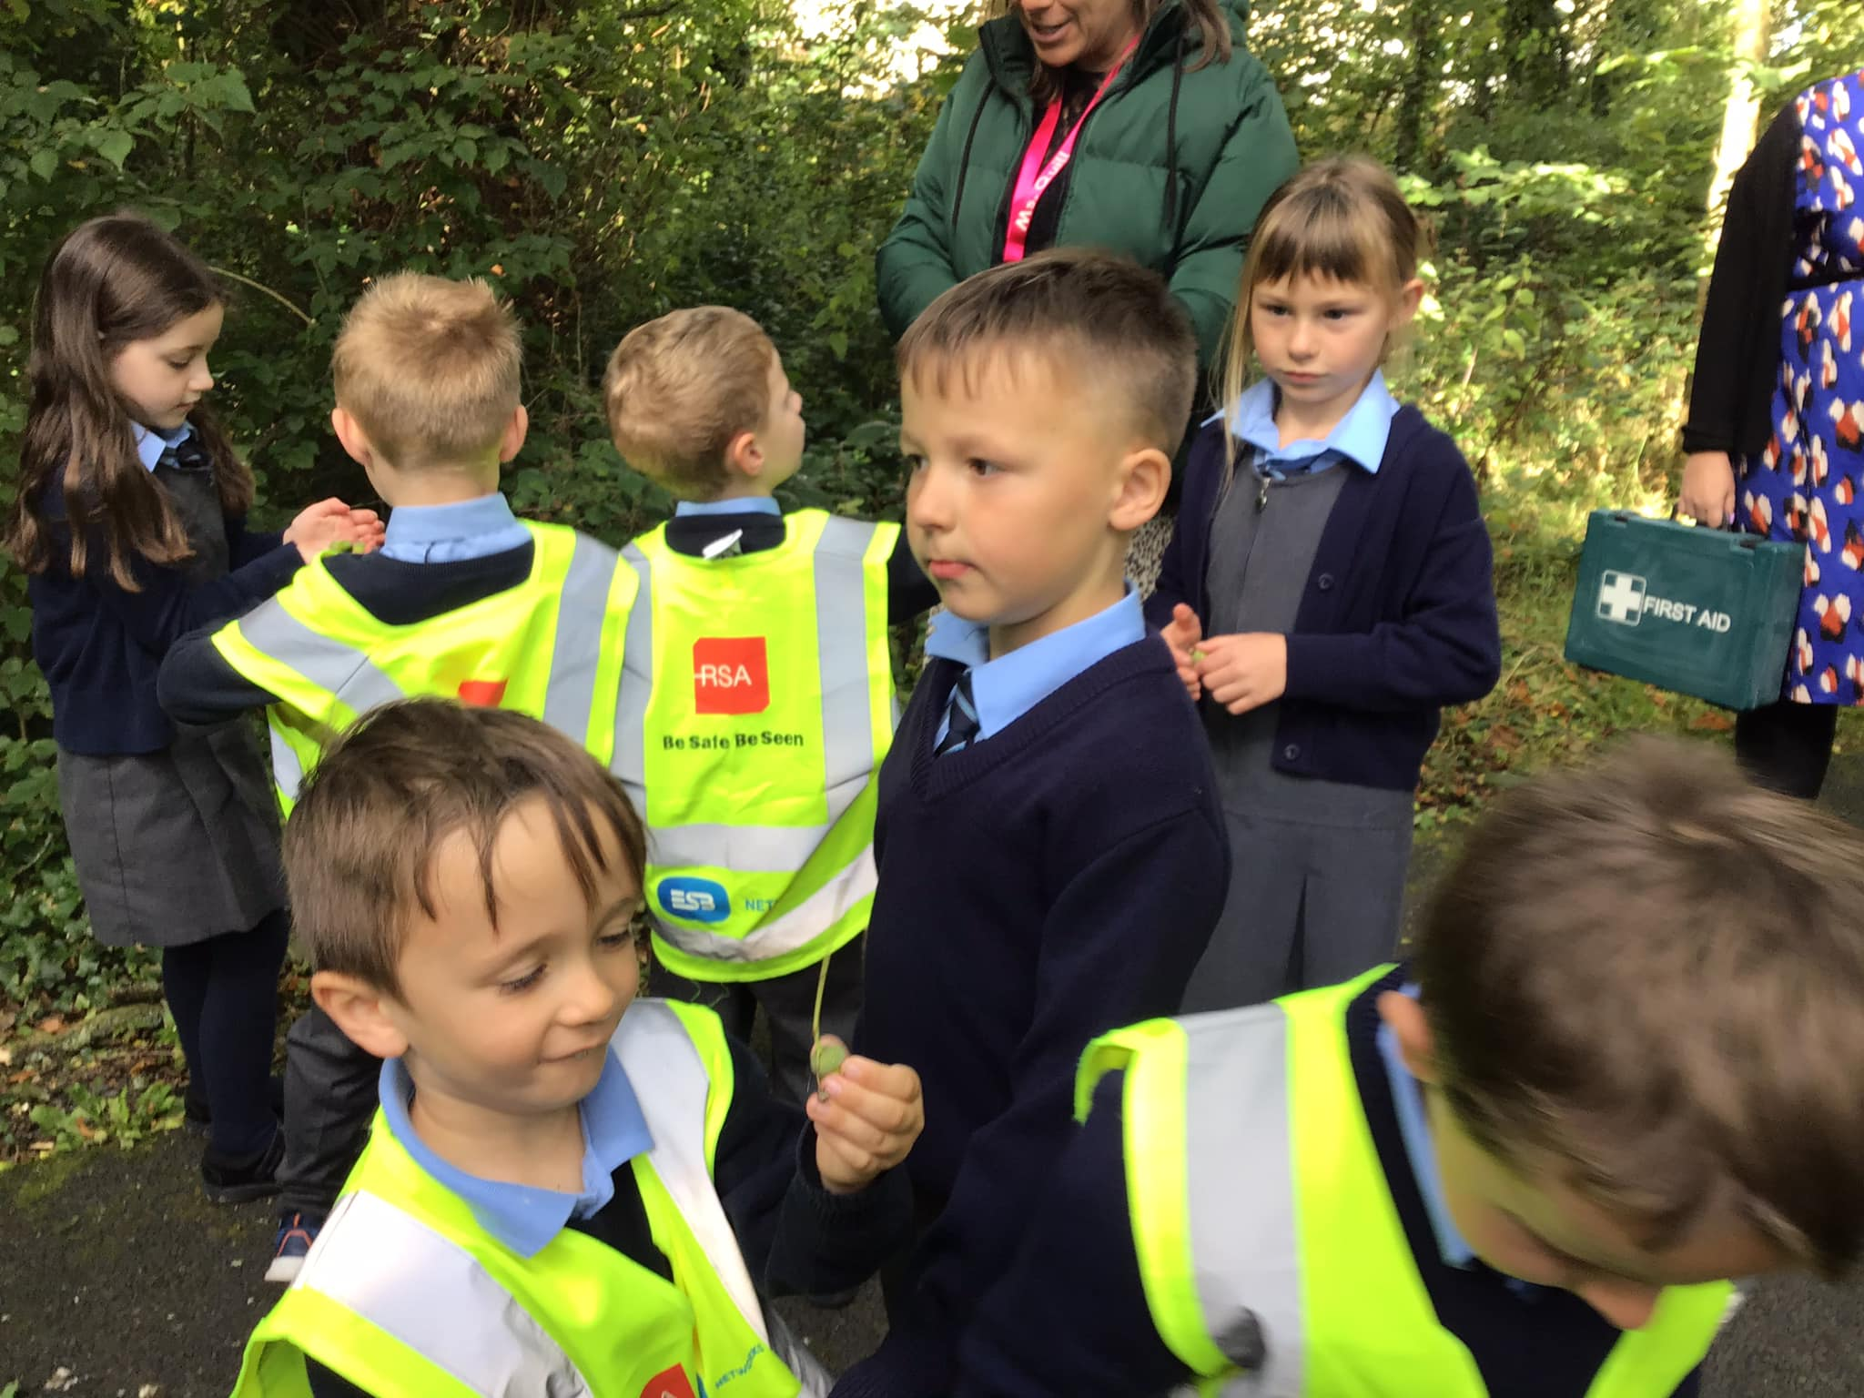
Autumn walks through the forest

Slide 20
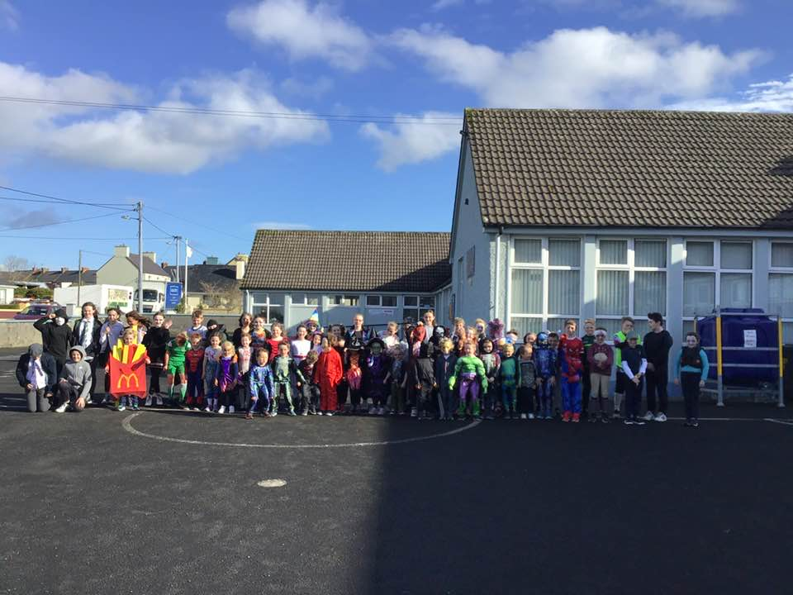
Halloween Chase

Slide 21
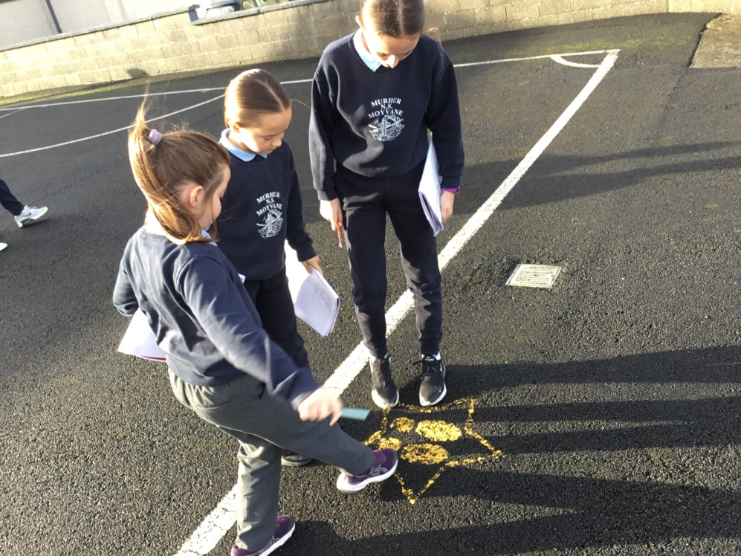
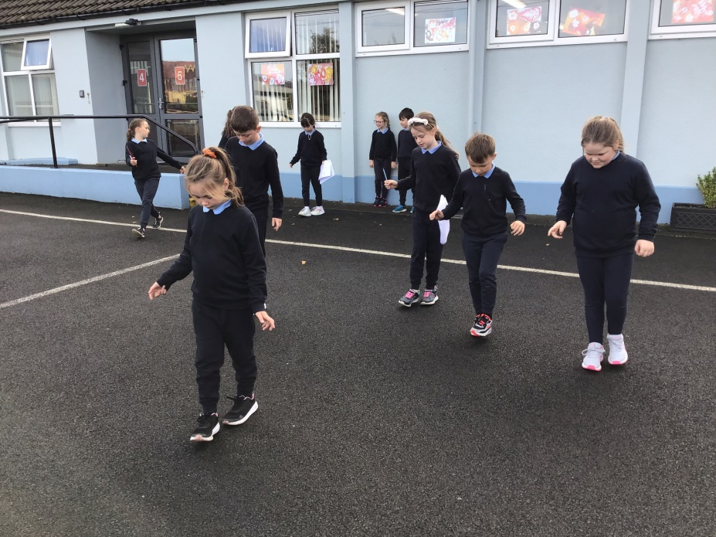
Active
learning
Through Maths Trails

Slide 22
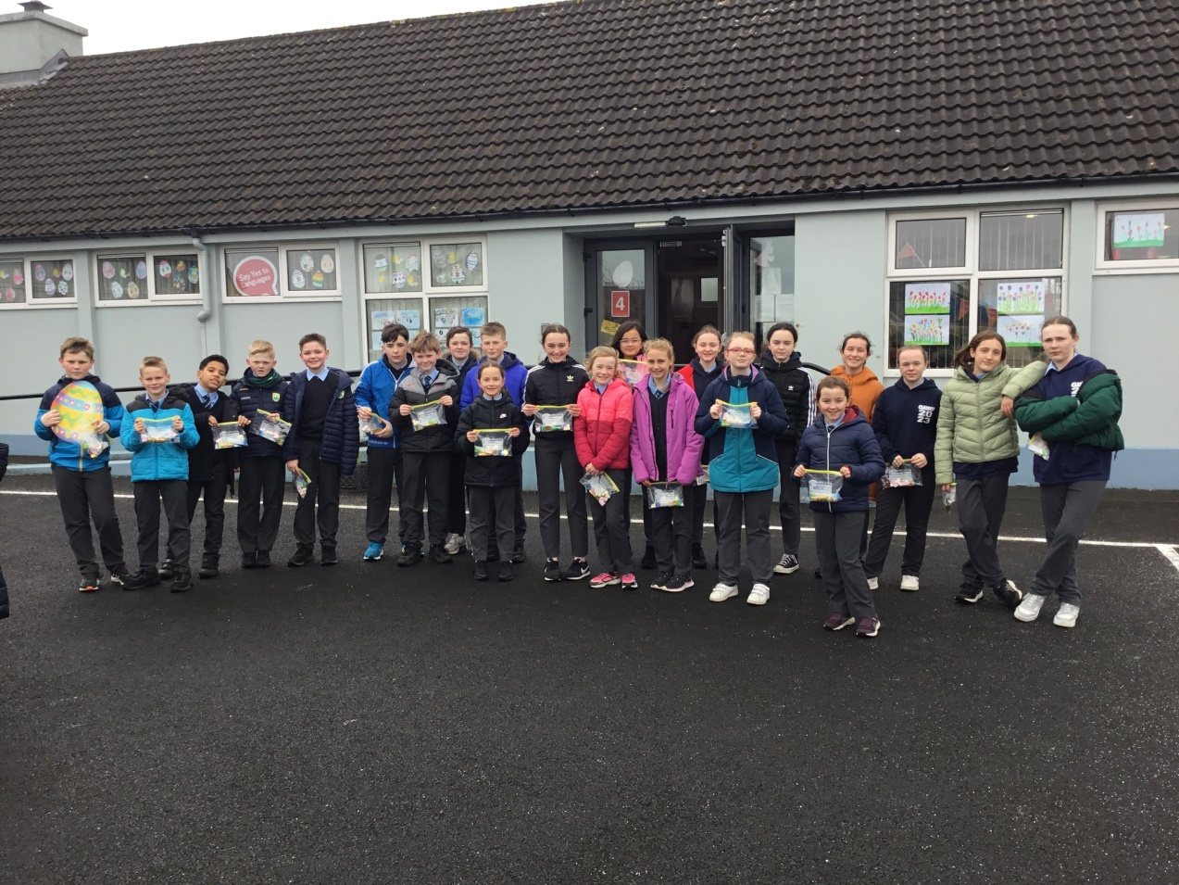
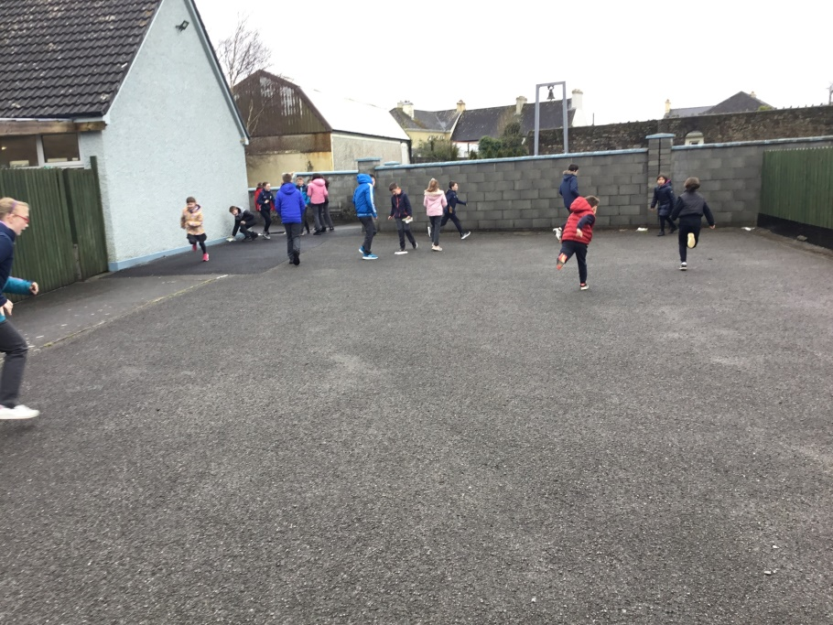
Easter Egg Hunt

Slide 24
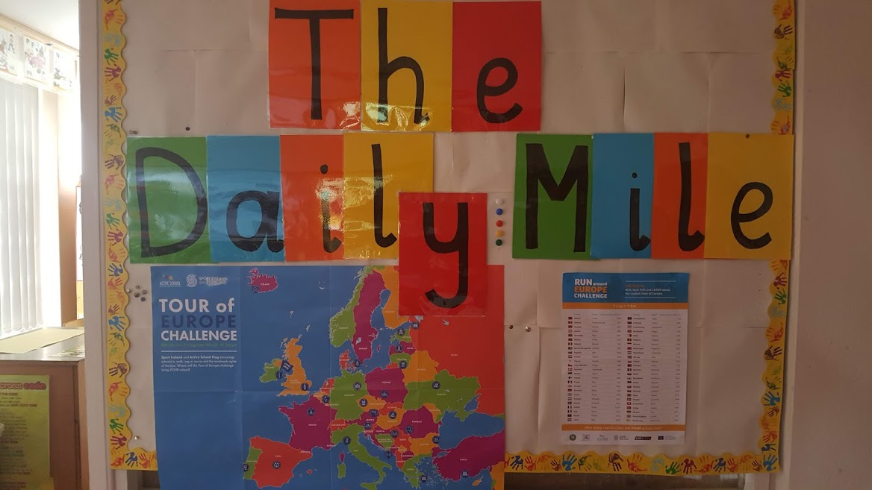

Slide 25
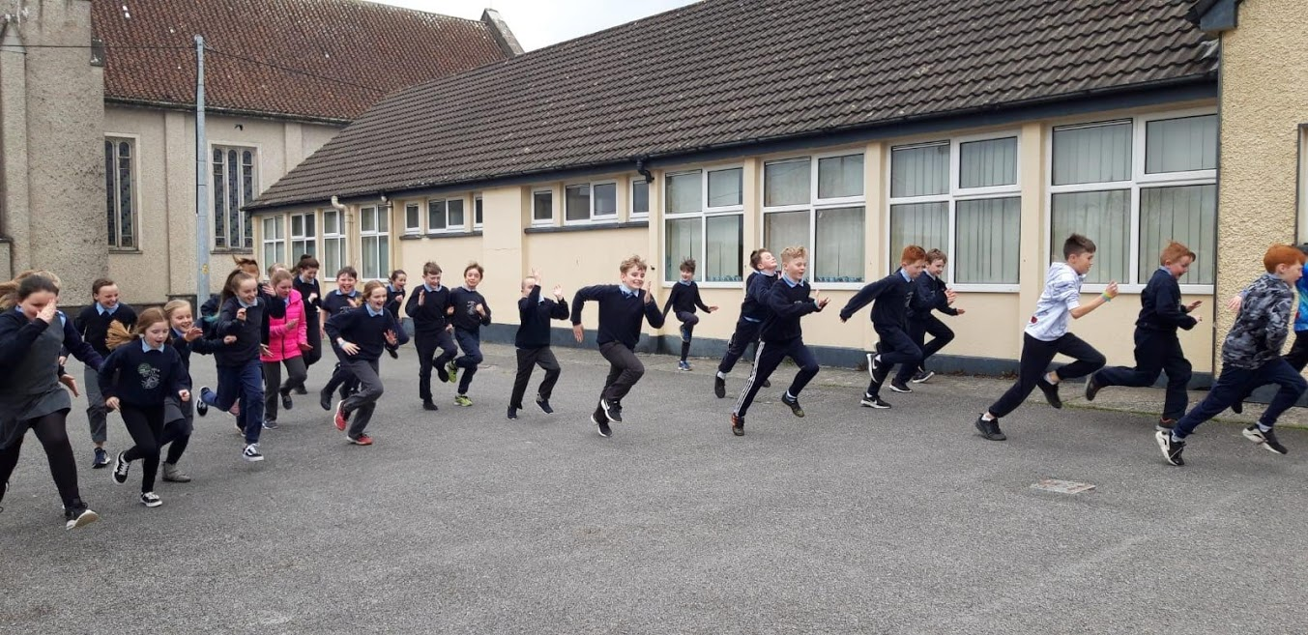
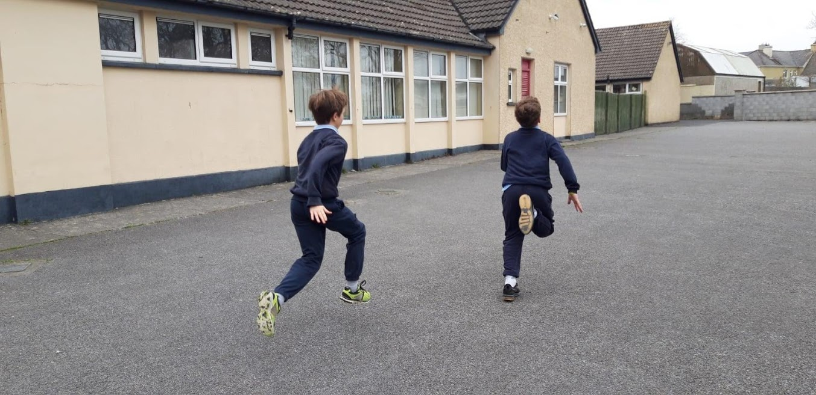

Slide 26
Partnerships
Moyvane G.A.A. Club
Moyvane Badminton Club
Ballybunion Health and Leisure Centre
Cumann na mBunscol
P.A.W.S.
Listowel Rugby Club
FAI 5-a-side soccer

Slide 27
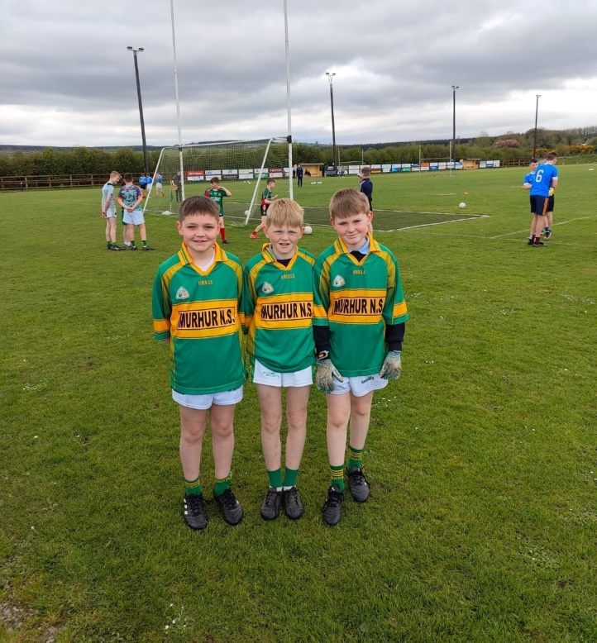
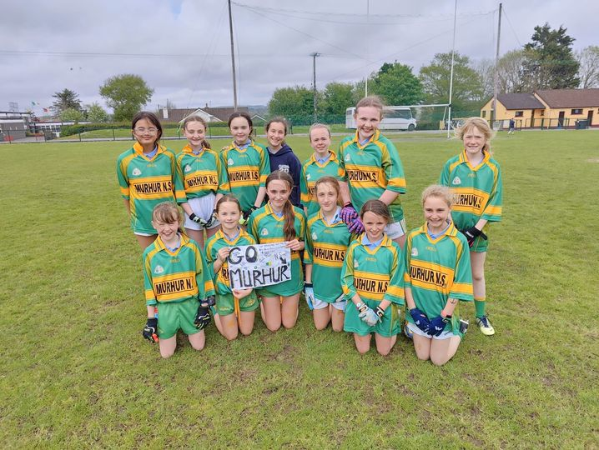
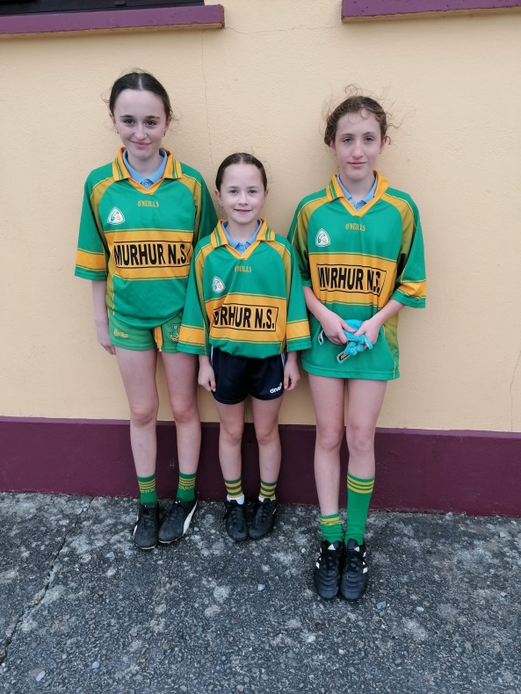
Football every second Wednesday with John Barry.
The boys and girls also competed in the Cumann na
mBunscoil competitions.

Slide 28
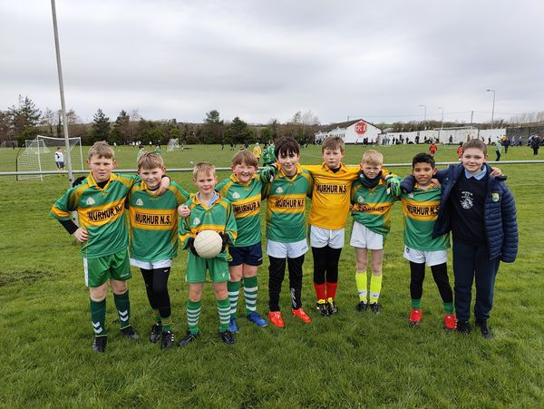
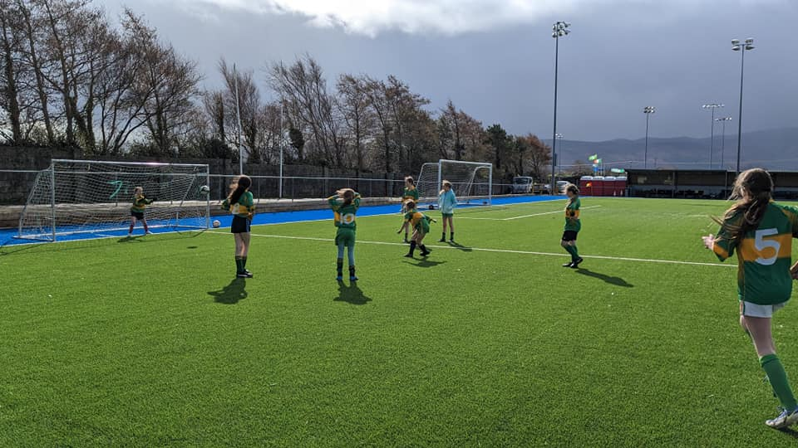
FAI 5-a-side Soccer
The boys and girls competed in the FAI 5-a-side soccer tournament in North Kerry.

Slide 29
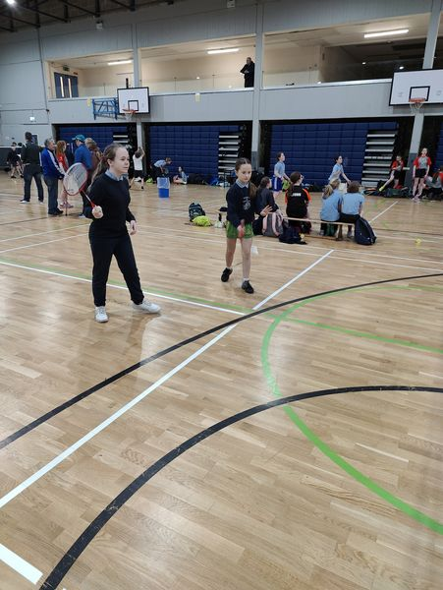
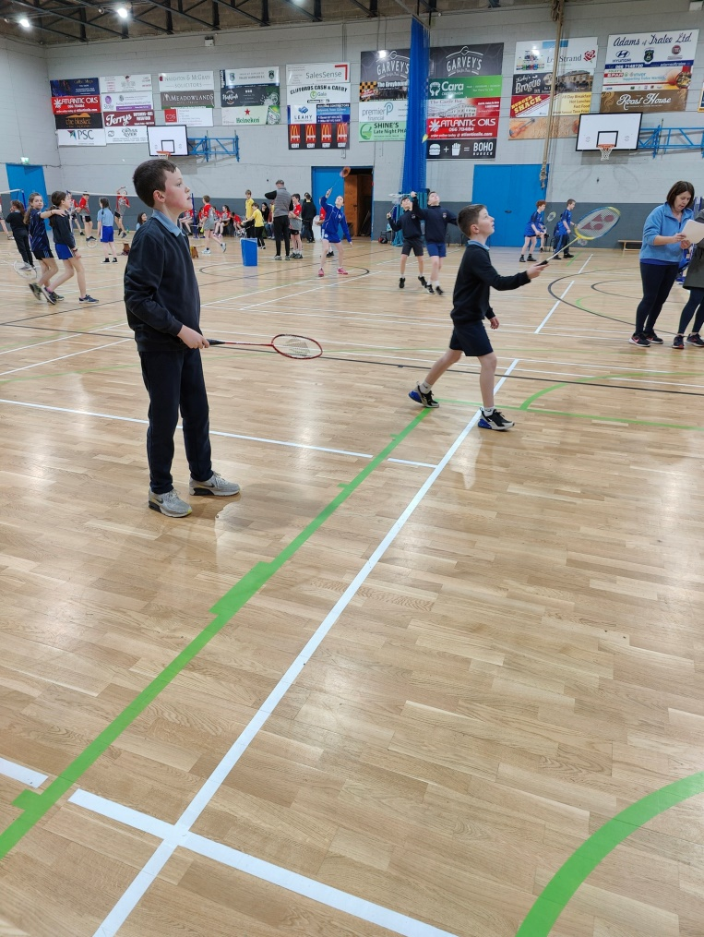
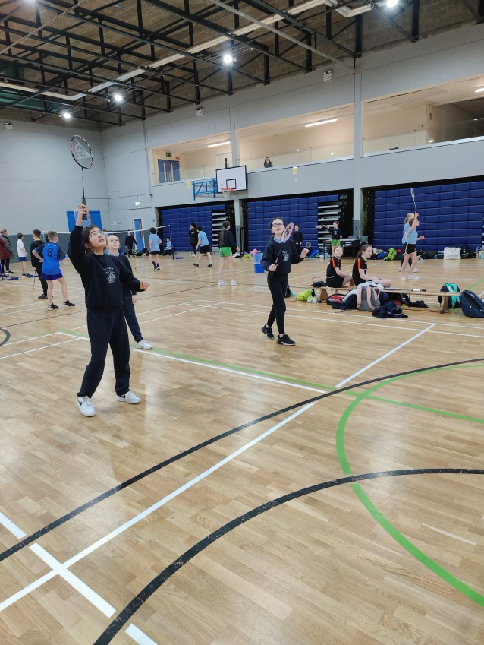
Pupils were coached by the local badminton club and also competed in the kerry badminton tournament.

Slide 30
We are delighted with our School Walkway too. It goes from our school, down the road, in through the village, around by the playground and back to the school. Our community are really enjoying it also.

Slide 31
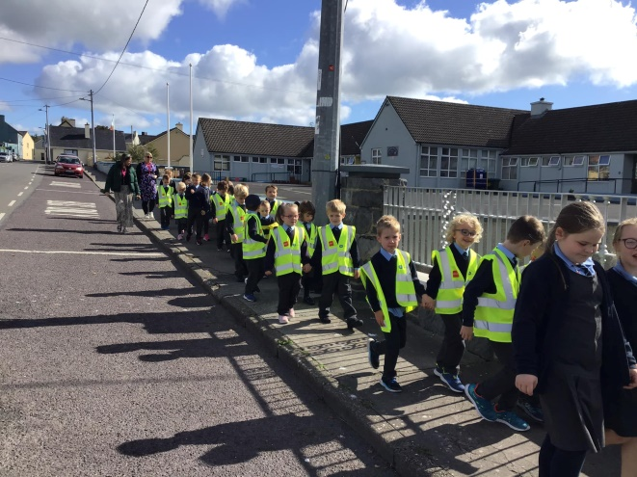
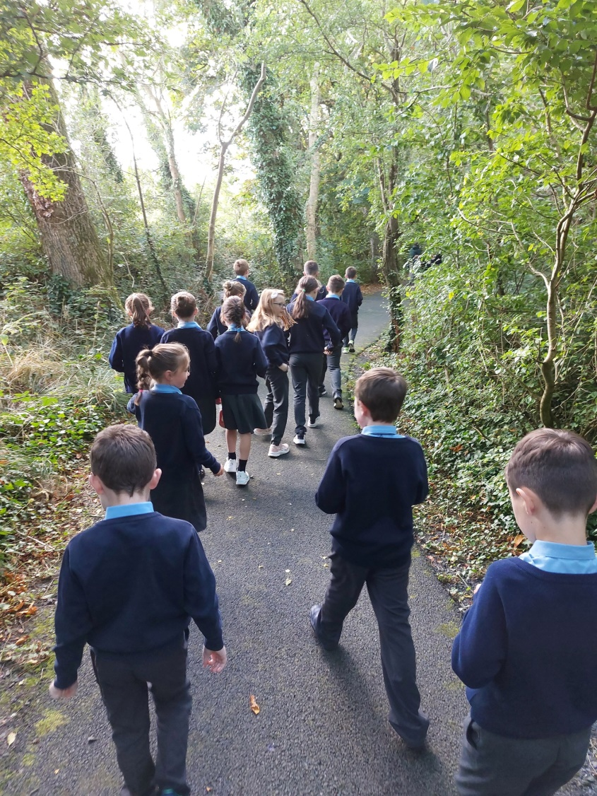
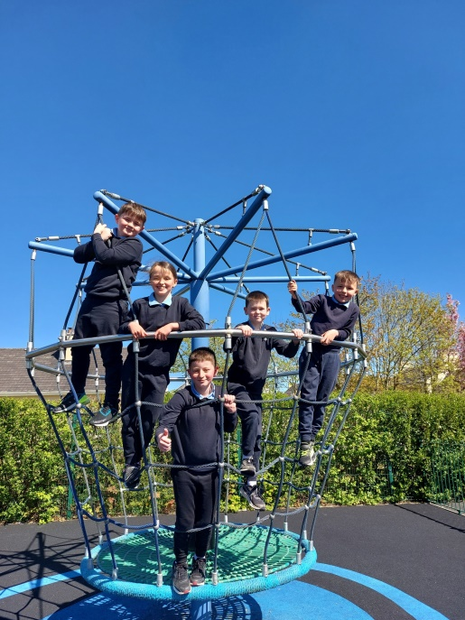

Slide 32
What Clubs Are You In?
Survey Results completed by our A.S.C.–
Moyvane Badminton
Moyvane G.A.A.
Athea and Duagh Basketball Clubs
Listowel Soccer Club
Irish Dancing
Ballybunion Swimming Club
Listowel Athletics
Tae Kwan Do Listowel
Listowel Rugby Club
Ballyduff Boxing Club
Ballyduff HurlingClub
Abbeyfeale Kick Boxing Club

Slide 33
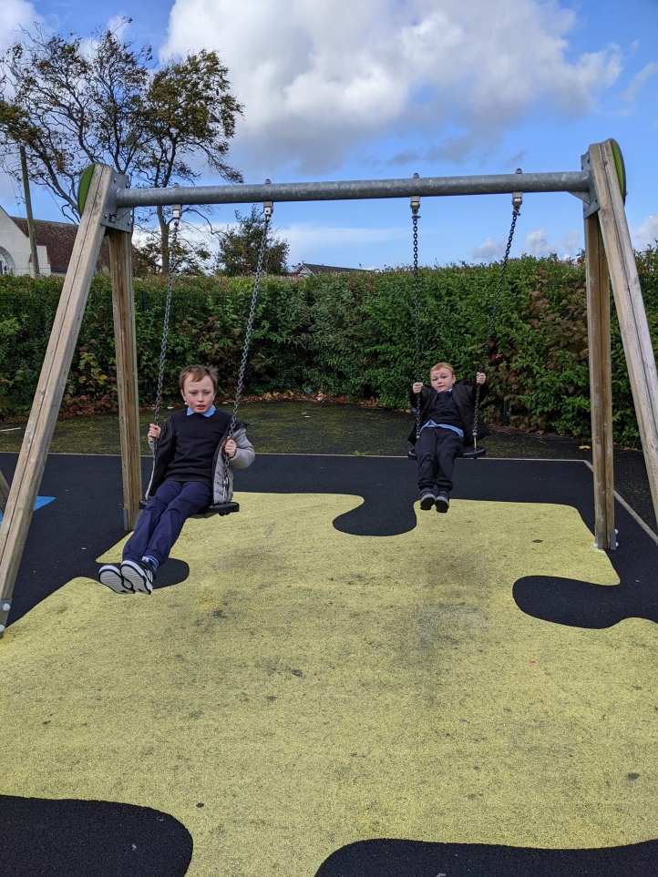
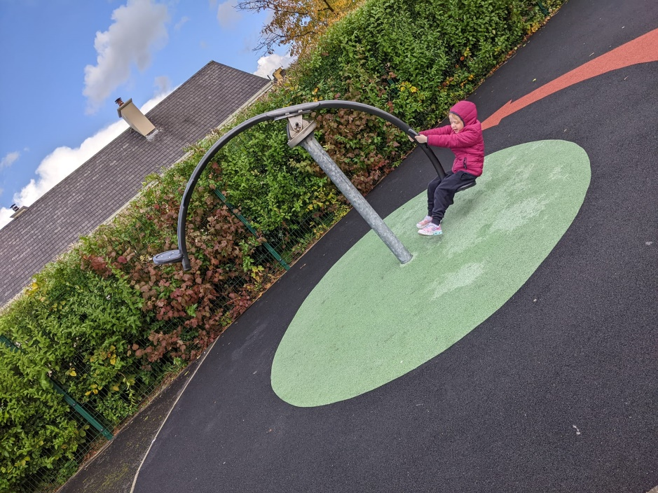
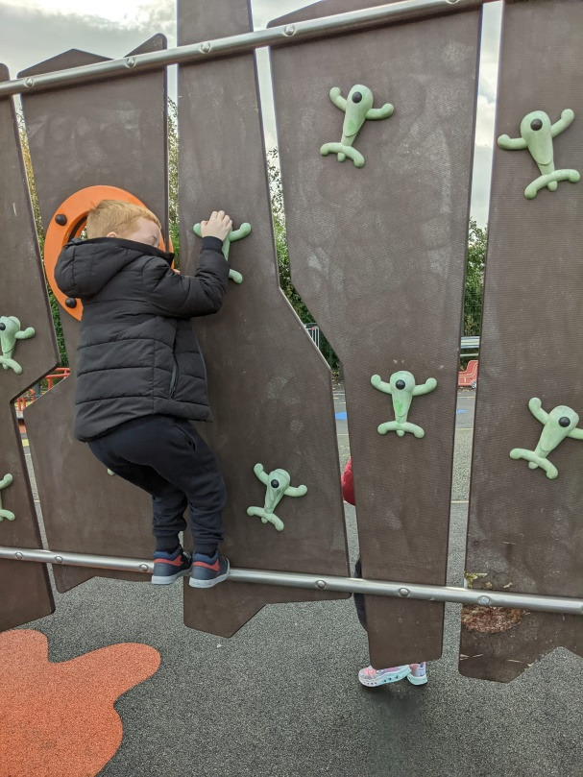
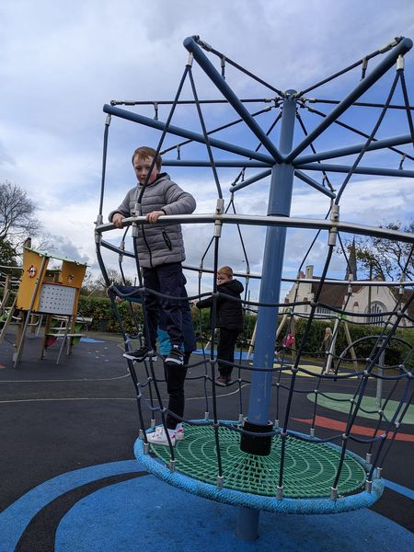
Making use of our local amenities......

Slide 34
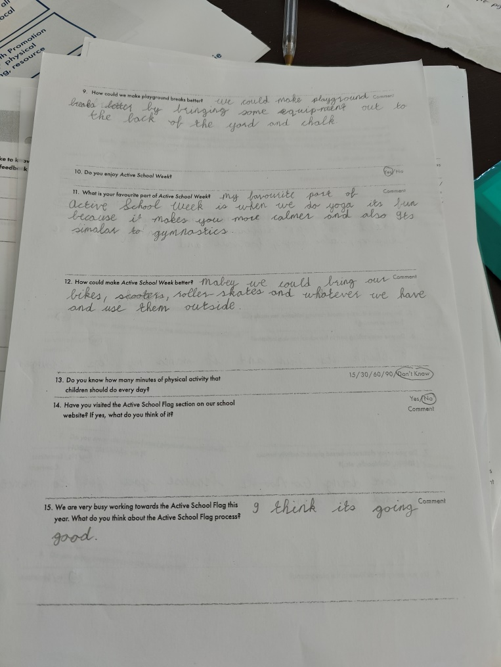
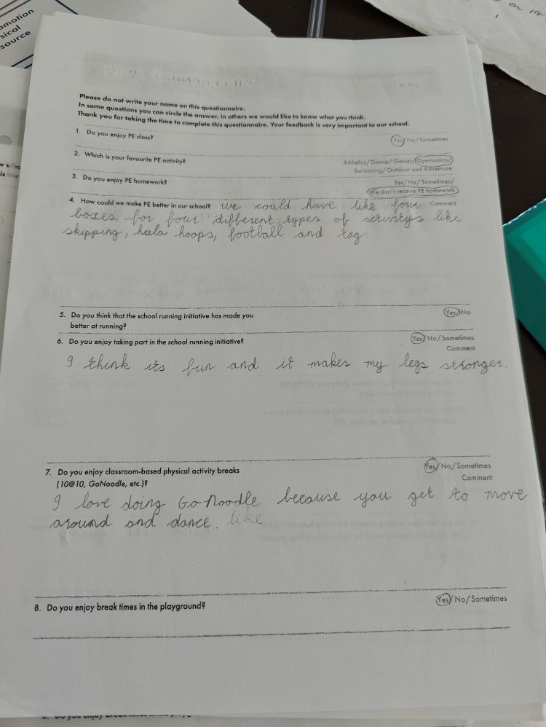
Pupil and Parent Questionnaires
We carried out questionnaires with the pupils and parents in order to get feedback on PE, ASF, ASW and other active initiatives that take place in the school. We reflected and used this feedback to implement more engaging activities at break times and to invite parents to use their skills to coordinate
https://www.surveymonkey.com/r/SMHQGJ8

Slide 35
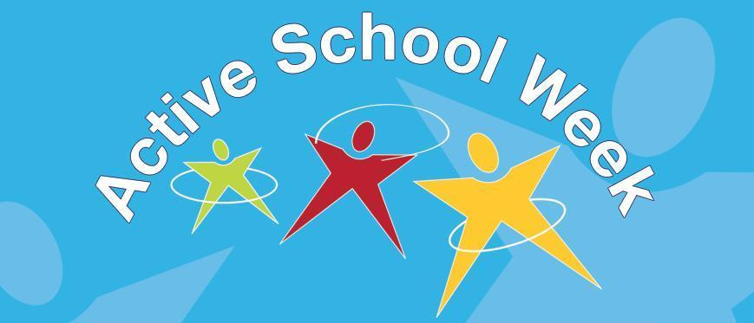
12th – 16th of June

Slide 36
Active Schools Week was jammed packed for 2023. It began on Monday with a coaching session in Badminton with two coaches from Moyvane Badminton Club. Children practiced their badminton skills in a fun and interactive way. That afternoon, Ms. Finnegan organised activities for every class to give them the opportunity to learn and develop their skills at hurdles, javelin throwing, reaction starts and relay races. On Tuesday, children were coached in basketball by Mrs. Quill. They warmed up their hands with some ball handling and then had a few games of hot seat and a blitz to finish. Wednesday began in a very calm and peaceful way thanks to a parent who volunteered to guide children in meditation and yoga poses. The children learned strategies for breathing effectively and stretching their bodies. The children then took to their bikes and other vehicles with wheels for a drive around the yard to practice balance, agility and learn the rules of the road. Thursday, saw the finals of the Patrick Curtin Memorial Cup come to a close with excellent displays of skill in football from both teams. The senior room also organised and coordinated activities for the younger classes to take part in. On the last day of the week, the week finished on a high as the children enjoyed multiple fun races including egg and spoon race, welly throw, three-legged race, sack race and tug-o-war. A great week full of activity was had by each and every child.
Check out our website for photos of the week.

